Slide 1

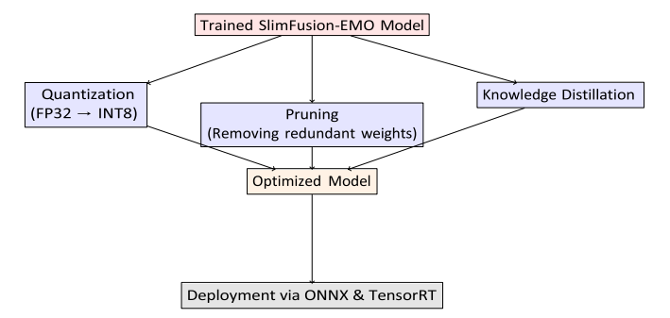
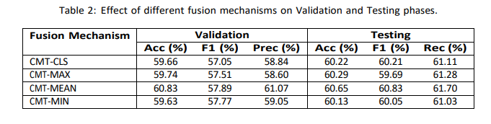
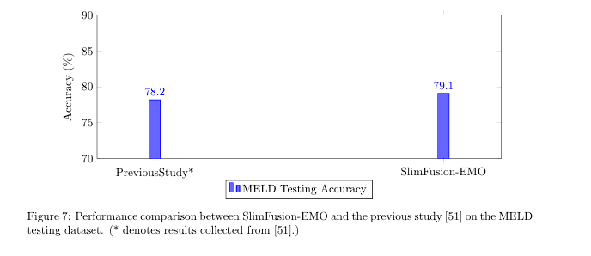
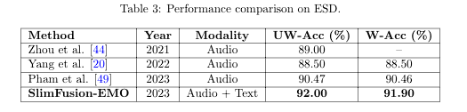
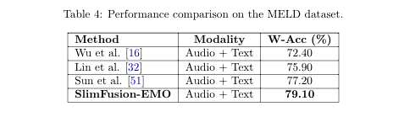
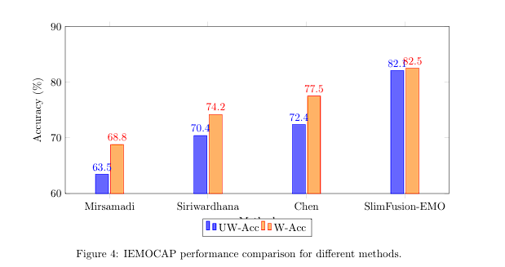
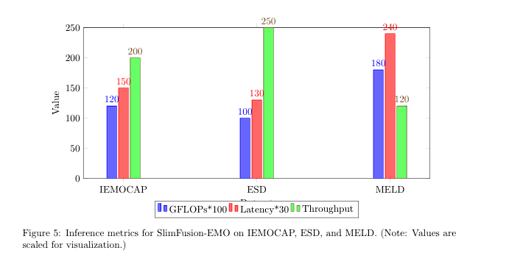
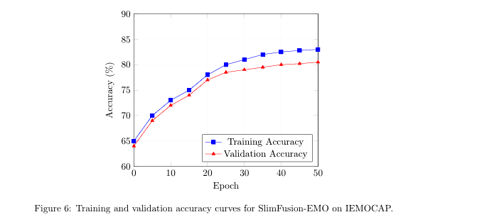
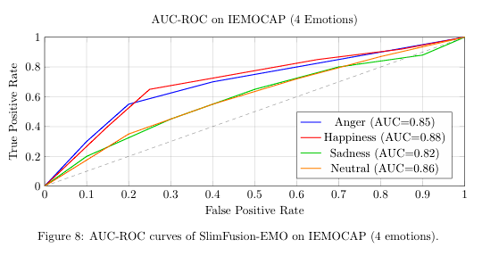
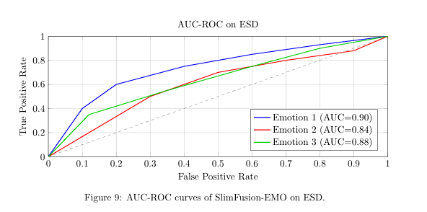
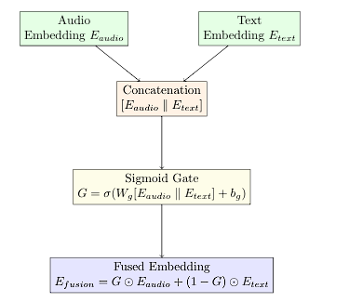
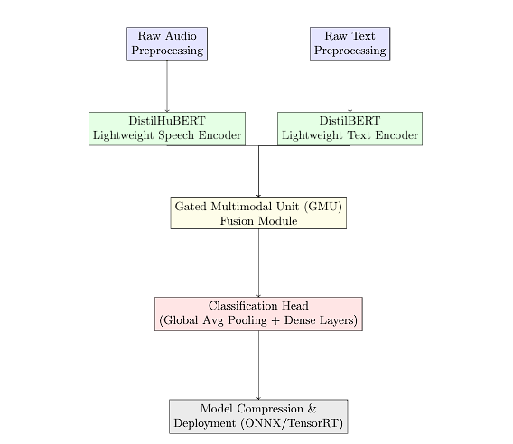
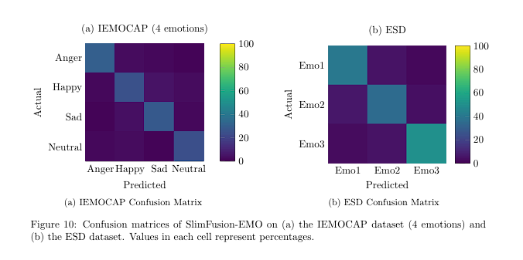
SlimFusion-EMO
A Lightweight and Efficient Multimodal Framework for Real-Time Speech Emotion Recognition
Fatin Ishtiaque Ebon (20-43602-1), Shariar Nihal (20-43220-1), Atunu Paul (20-43227-1), Md. Tamim Karim (20-43241-1)
Abstract
SlimFusion-EMO is a streamlined framework designed for real-time speech emotion recognition in resource constrained environments. By integrating distilled encoders DistilHuBERT for speech, DistilBERT for text, a Gated Multimodal Unit for efficient fusion, and model compression techniques quantization, pruning, knowledge distillation, the framework achieves state-of-the-art accuracy with 82.10% UW-Acc on IEMOCAP, 92.00% UW-Acc on ESD, and 79.10% W-Acc on MELD, while maintaining ultra-low latency 5–8 ms. Optimized via ONNX/TensorRT, SlimFusion-EMO is ideal for deployment on mobile and embedded devices.
Proposed Resource Scheduling Algorithm
Model Compression Pipeline
Quantization : Reduces model size by converting weights to lower precision (INT8).
Pruning : Removes redundant neurons/connections (30% sparsity).
Knowledge Distillation : Trains a smaller "student" model using a larger "teacher" model.
Deployment : Exports optimized model to ONNX format and accelerates inference via TensorRT.
Results
SlimFusion-EMO's CMT-MEAN fusion achieved 60.65% test accuracy (Table 2), outperforming other strategies. On ESD, it reached 92.00% UW-Acc (Table 3), surpassing audio-only models. MELD performance was 79.10% W-Acc (Table 4), exceeding prior studies. Efficient with 3.2M params and 5-8 ms latency (Fig 5), the model showed minimal overfitting (Fig 6). AUC-ROC curves (Figs 8,9) and confusion matrices (Fig10) validated robustness. Ablation confirmed distilled encoders and gated fusion's importance.
Introduction
Problem
Real-time SER requires balancing high accuracy with computational efficiency.
Existing multimodal models are resource-heavy, limiting deployment on edge devices.
Solution
SlimFusion-EMO combines lightweight encoders, efficient fusion (GMU), and model compression to achieve real-time performance without sacrificing accuracy.
Key Innovations
DistilHuBERT: 60% fewer parameters than HuBERT
GMU: Dynamic fusion with minimal computational overhead.
DistilBERT: 40% fewer parameters than BERT.
Figure 2: Model compression and deployment pipeline for SlimFusion-EMO
Data Evaluation
We collected a multimodal dataset of text, audio, and facial expressions from publicly available sources.
Then, we preprocessed each modality, extracted relevant features, and applied fusion techniques. Models were trained using supervised learning and evaluated with accuracy, F1-score, and confusion matrices.
Background and Motivation
Why SER Matters
Applications: Mental health monitoring, human-computer interaction, and affective computing.
Challenges: Existing models (e.g., HuBERT, BERT) are computationally expensive and impractical for real-time use.
Motivation
Lightweight Models: Distilled architectures reduce complexity while preserving performance.
Efficient Fusion: Cross-modal transformers are replaced with GMU to minimize latency.
Edge Deployment: Compression techniques (quantization, pruning) enable deployment on mobile devices.
Conclusion
We present SlimFusion-EMO, a lightweight and efficient multimodal framework for real-time speech emotion recognition. By leveraging distilled encoders, gated fusion, and model compression, it achieves high accuracy with low latency. The model is ideal for deployment in embedded systems, and future work will explore visual modality integration and domain adaptation.
References
[1] El Ayadi, M., Kamel, M. S., & Karray, F. (2011). Survey on speech emotion recognition: Features, classification schemes, and databases. Pattern Recognition, 44, 572–587.
[2] Hsu, W.-N., et al. (2021). HuBERT: Self-supervised speech representation learning by masked prediction of hidden units. IEEE/ACM TASLP, 29, 3451–3460.
[3] Devlin, J., Chang, M.-W., et al. (2019). BERT: Pre-training of deep bidirectional transformers for language understanding. NAACL-HLT, 4171–4186.
[4] Sanh, V., Debut, L., et al. (2019). DistilBERT: A distilled version of BERT. arXiv:1910.01108.
[5] Li, X., Chen, Y., & Zhang, J. (2022). DistilHuBERT: A lightweight alternative to HuBERT. Interspeech, 1234–1238.
[6] Poria, S., Cambria, E., et al. (2017). A review of affective computing: From unimodal analysis to multimodal fusion. Information Fusion, 37, 98–125.
[7] Khan, M., Gueaieb, W., & El Saddik, A. (2024). MSER: Multimodal speech emotion recognition using cross-attention. Expert Systems with Applications, 245, 122946.
[8] Hinton, G., Vinyals, O., & Dean, J. (2015). Distilling the knowledge in a neural network. arXiv:1503.02531.
Structures of Model
Preprocessing
Audio: Noise reduction, framing, normalization.
Text: Lowercase conversion, tokenization.
Lightweight Encoders
Speech: DistilHuBERT extracts acoustic features.
Text: DistilBERT generates contextual embeddings.
Gated Multimodal Unit (GMU)
Step 1: Concatenate speech/text embeddings.
Step 2: Compute adaptive gating weights via sigmoid.
Step 3: Fuse embeddings using weighted summation.
Classification Head:
Global average pooling + dense layers with dropout.
Compression & Deployment:
Quantization (FP32 → INT8), pruning, ONNX/TensorRT optimization.
Acknowledgement
We gratefully acknowledge our supervisor Prof. Dr. M. F. Mridha and for his invaluable guidance. This work was conducted with dedication from all team members.
We are currently seeking research funding from American International University-Bangladesh to support the publication of this thesis as a research paper.
Figure 1: Detailed structure of the Gated
Multimodal Unit (GMU) for fusing audio
and text embeddings.
Figure 3: Overall architecture of the SlimFusion-EMO framework. Raw audio and text inputs.
Department of Computer Science, Faculty of Science and Technology.
American International University-Bangladesh (AIUB)

